Slide 1
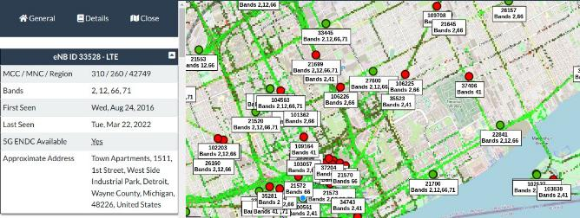
Surveying Your Environment
The easiest way to survey the surrounding environment for cellular towers is https://www.cellmapper.net/. This site will allow you to view a defined geographical location to see all the towers and their values that are being broadcasted.
66
February 21, 2024
Joseph Reith

Slide 2
Surveying Your Environment
Find the local tower to here and record the downlink frequency associated with the tower.
We will use this information to tune our SDR's and view a waterfall representation of LTE data with a program called gqrx.
February 21, 2024

Slide 3
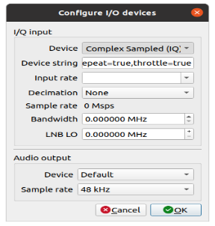
Surveying Your Environment
Issue the following command to launch gqrx:
Gqrx
Click on the devices option to show the list of plugged in devices. You should see the window as shown above.
February 21, 2024

Slide 4
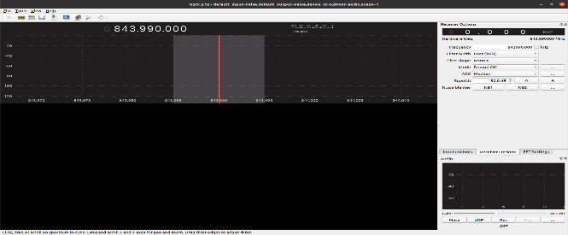
Surveying Your Environment
Select the device that matches what you have plugged in and click the OK button.
You should see a screen like the one above.
February 21, 2024

Slide 5
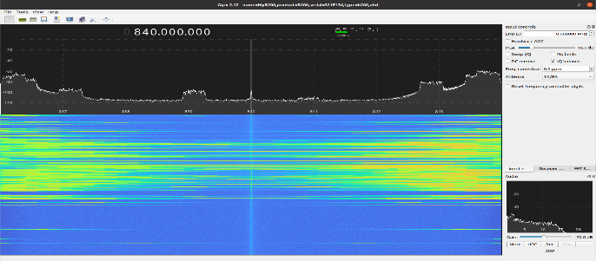
Surveying Your Environment
Using your mouse scroll wheel set the frequency at the top of the application to the one you wrote down earlier while looking for a local tower. Once tuned you should see LTE data as shown in the picture above. You may need to adjust the gain to see the data clearly.
February 21, 2024

Slide 6
Lab 2 – Configuring srsRAN Components

Slide 7
Configuring srsRAN
When configuring srsRAN software there are a couple parameters that will need to be modified to ensure we do not interrupt any surrounding signals. These parameters are also important to being able to connect the TCU to the cellular tower.
These include:
MCC (Mobile Country Code)
MNC (Mobile Network Code)
APN (Access Point Name)
EARFCN (Pre-defined Uplink and Downlink Frequency pairs)
Tx Gain
Rx Gain
February 21, 2024
Joseph Reith

Slide 8
Configuring srsRAN
All configuration files that will need to be modified can be found in the directory below along with all relevant config files that we will be modifying.
Directory:
/root/.config/srsran/ Files:
epc.conf
enb.conf
user_db.csv
February 21, 2024
Joseph Reith

Slide 9
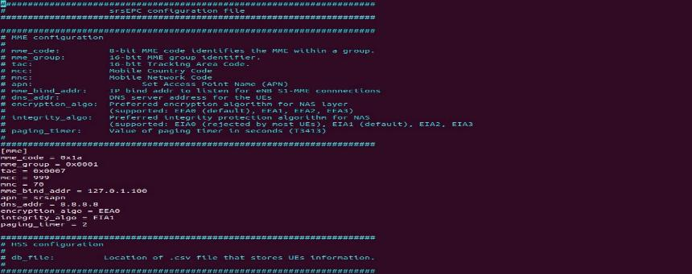
Configuring srsEPC
Issue the following command to edit the epc.conf file:
sudo nano /root/.config/srsran/epc.conf
You should see the config file as shown above
February 21, 2024
Joseph Reith

Slide 10
Configuring srsEPC
Edit dns_addr field so it points to 8.8.8.8.
Edit MCC to say 999 and the MNC to say 70
Set apn to srsapn
Now save and close the file using the key sequence
Ctrl + x
Press y to save as the same name
Hit enter
February 21, 2024
Joseph Reith

Slide 11
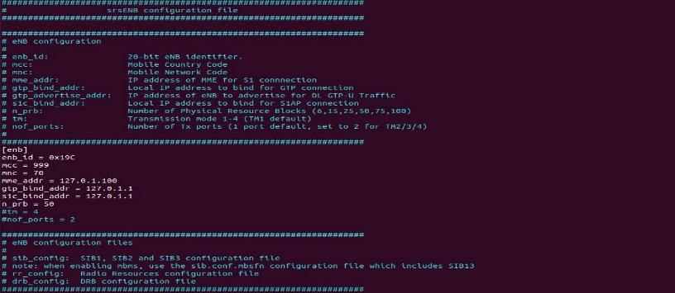
Configuring srsENb
Issue the following command to edit the enb.conf file:
sudo nano /root/.config/srsran/enb.conf
You should see the config file as shown above
February 21, 2024
Joseph Reith

Slide 12
Configuring srsENb
Edit MCC and MNC to match what you entered in the epc.conf file
Scroll down to the [rf] header
Edit dl_earfcn to say 3400(need more of them)
tx_gain = 40 (still finding lowest number)
rx_gain = 40 (still finding lowest number)
Now save and close the file using the key sequence
Ctrl + x
Press y
Hit enter
February 21, 2024
Joseph Reith

Slide 13
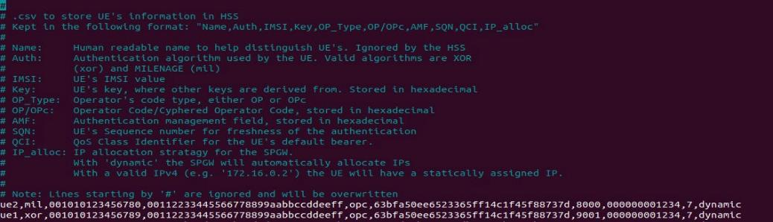
Configuring HSS
The file user_db.csv hold all the authentication and authorization information for an allowed UE. Issue the following command to edit the epc.conf file:
sudo nano /root/.config/srsran/user_db.csv You should see the config file as shown above
February 21, 2024
Joseph Reith

Slide 14
Configuring HSS
Enter your SIM cards information for the following <values>:
<unique name>,mil,<IMSI>,<Ki key>,opc,<OPC key>,9000,0000000063af,9,dynamic
Now save and close the file using the key sequence
Ctrl + x
Press y
Hit enter
February 21, 2024
Joseph Reith

Slide 15
Lab 3 – Programming a SIM Card

Slide 16
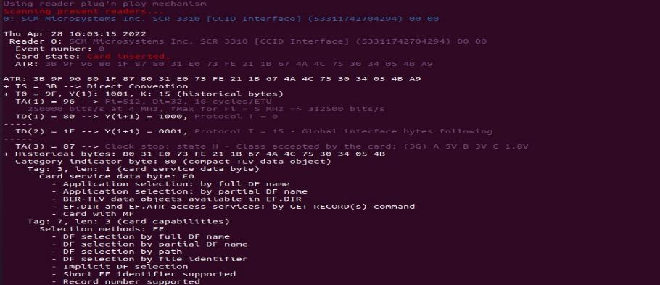
Programming SIM Cards
Connect your SIM card reader, insert the programmable SIM card, and check connectivity by running the following command in a terminal: sudo pcsc_scan
If your reader and card is recognized, the end of your output will look similar to below:
February 21, 2024
Joseph Reith

Slide 17
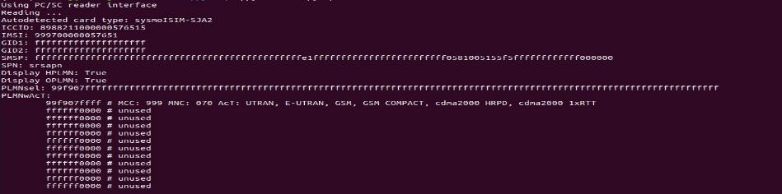
Programming SIM Cards
Next we need to test the SIM programming application in order to find the correct port assignment that was given to the SIM card reader. This is done by issuing the following command from the ~/pysim directory:
./pySim-read.py
If everything is setup correctly and the port is on the default of 0 you will see output similar to below:
February 21, 2024
Joseph Reith

Slide 18
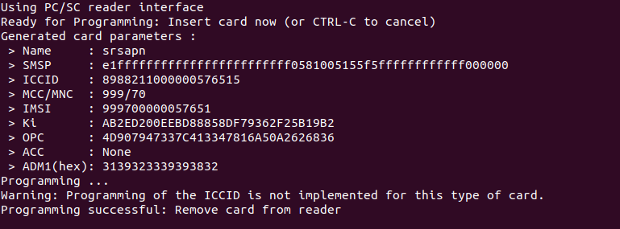
Programming SIM Cards
Now we have to program the SIM to be able to connect to our LTE network. Below is the command that is used to program the SIM’s, you need to fill the values in with your specific team’s SIM card information that was provided to you.
./pySim-prog.py -p <Port your sim card reader was on> -x <Network MCC> -y
<Network MNC> -n <Operator Name> -t <SIM card type> -i <imsi> -s <iccid> -o
<OPC Key> -k <Ki> -a <ADM Pin>
If all values are entered correctly, you will see output similar to the picture below.
February 21, 2024
Joseph Reith

Slide 19
Lab 4 – Connecting the TCU to Your Tower

Slide 20
Starting srsRAN
To start the srsRAN program open up two terminals.
In the first terminal you want to start the EPC first, issue the following command
sudo srsepc
In the second terminal you want to start the ENb, issue the following command
sudo srsenb --gui.enable=1
February 21, 2024
Joseph Reith

Slide 21
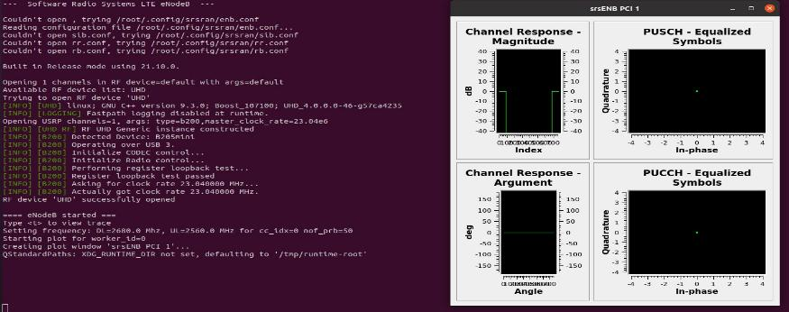
Starting srsRAN
You should see a GUI screen pop up displaying the current channel activity as seen above.
February 21, 2024
Joseph Reith

Slide 22
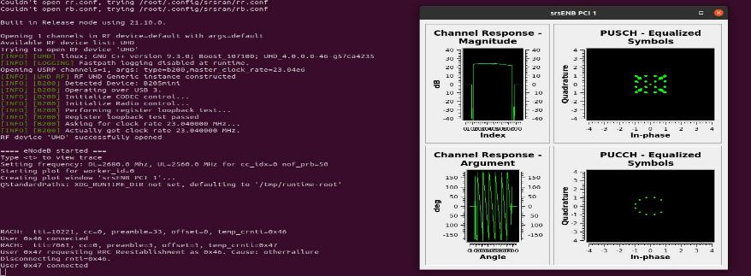
Starting srsRAN
Once the TCU connects to your tower you should get a user connected message as seen in the lower left of the picture. Along with the user connected message a visual indicator can be seen in the GUI. All 4 windows will show the different aspects of the LTE connection.
February 21, 2024
Joseph Reith

Slide 23
Starting srsRAN
Once the TCU connects to your tower you should get a user connected message as seen in the lower left of the picture. Along with the user connected message a visual indicator can be seen in the GUI. All 4 windows will show the different aspects of the LTE connection.
February 21, 2024
Joseph Reith

